Slide 1
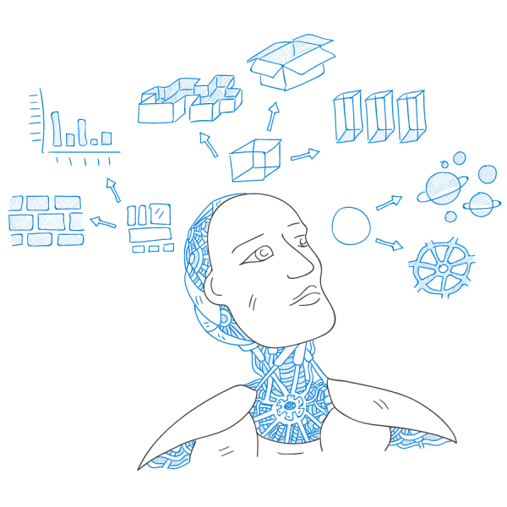
Introduction to Machine Learning
By-Ashish Vishwakarma
Mtech CSE IITBhilai

Slide 2
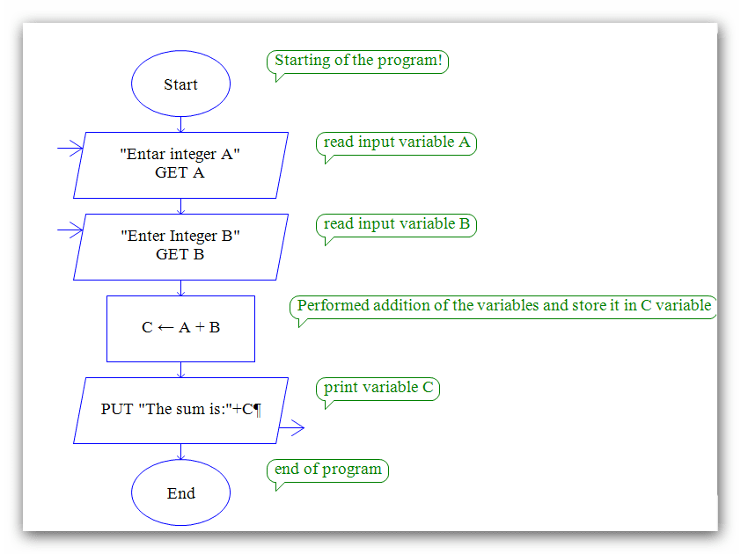

Write a program to classify between dog and a cat ?

Slide 3
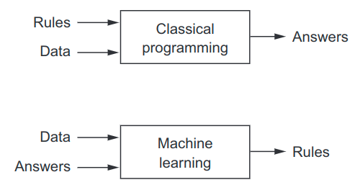
Machine learning: a new programming paradigm
A computer program is said to learn from experience E with respect to some class of tasks T and performance measure P, if its performance at tasks in T, as measured by P, improves with experience E

Slide 4
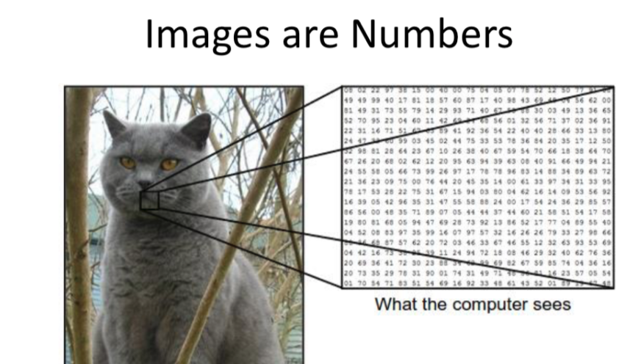
When to Use Machine Learning ?
Can’t code the rule: When rules depend on too many factors and many of these rules overlap or need to be tuned very finely, it soon becomes difficult for a human to accurately code the rules. You can use ML to effectively solve this problem.

Slide 5
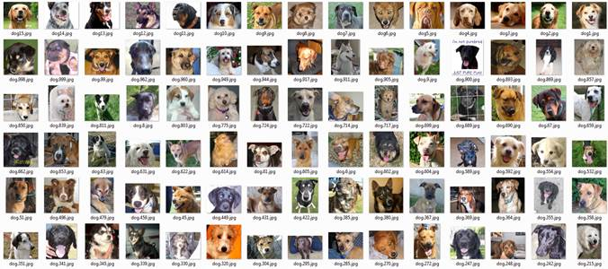
Can’t scale : You might be able to manually recognize a few hundred images and decide whether they are dog or cat. However, this task becomes tedius for millions of emails. ML solutions are effective at handling large-scale problems.

Slide 6
You don’t need ML if you can determine a target value by using simple rules, computations, or predetermined steps that can be programmed without needing any data-driven learning.

Slide 7
Examples:
Arithmetic operation ,eg : ADD,SUB,MUL,..
Logical operation,eg: AND ,OR ,NOT,....
Sorting numbers eg: Increasing ,Decreasing.
Rule based eg: Direct Formulas( V=IR),factorial,..

Slide 8
From where idea of ML come’s from ?

Slide 9
“AI began with an ancient wish to forge the gods.”
- Pamela McCorduck, Machines Who Think, 1979

Slide 10
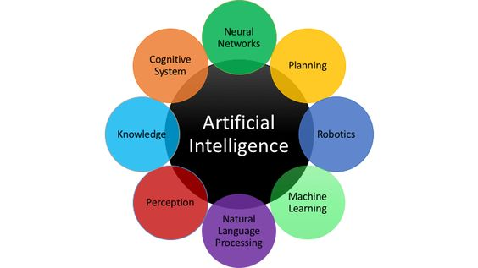
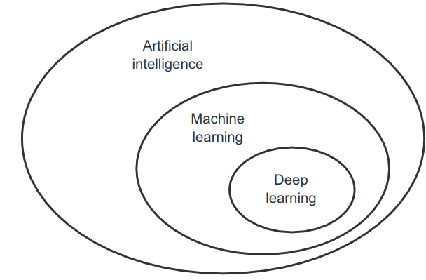
An effort to automate intellectual tasks normally performed by humans.
.

Slide 11


Slide 12
Some achievement’s:
Near-human-level image classification.
Near-human-level speech recognition.
Near-human-level handwriting transcription.
Improved machine translation.
Improved text-to-speech conversion.
Digital assistants such as Google Now and Amazon Alexa.
Near-human-level autonomous driving.
Improved ad targeting, as used by Google, Baidu, and Bing.
Improved search results on the web.
Ability to answer natural-language questions.
Superhuman Go playing.

Slide 13
ML in basic sciences

Slide 14
ML In Condensed Matter Physics:
“Understanding the wavefunction of a many-particle quantum system with relevant accuracy which can pave the way for the designing of new quantum materials and devices.”
Researchers are using ML algorithms to understand the phases of matter, which could lead to theoretical breakthroughs in quantum bit or even silicon
https://www.quora.com/profile/Juan-Felipe-Carrasquilla
Deep Learning for Tracking in High Energy Physics:
https://pdfs.semanticscholar.org/c2b3/951c35159a08d48c3624921927e98fd32302.pdf
The researchers deployed an LSTM approach and proposed an end-to-end solution for the HL-LHC track pattern recognition challenge
https://arxiv.org/pdf/1402.4735.pdf
deep learning techniques improved the classification metric by 8 percent

Slide 15
ML In Astrophysics:
processing the wide amount of astronomical data generated which are often heterogeneous in nature.
gain data-driven insights and visualize it further
https://arxiv.org/pdf/1411.5039.pdf
References:
PY 895 Machine Learning for Physicists. Fall 2018 http://physics.bu.edu/~pankajm/PY895-ML.html
A high-bias, low-variance introduction to Machine Learning for physicists https://arxiv.org/pdf/1803.08823.pdf
https://www.quora.com/What-are-the-connections-between-machine-learning-and-physics

Slide 16
Junction Tree Variational Autoencoder for Molecular Graph Generation:
automate the design of molecules based on specific chemical properties
https://arxiv.org/abs/1802.04364
Using Deep Reinforcement Learning to Generate Rationales for Molecules:
Learn to identify molecular substructures – rationales – that are associated with the target chemical property.
http://chem.csail.mit.edu/deep-reinforcement-learning.pdf

Slide 17
Predicting Organic Reaction Outcomes with Weisfeiler-Lehman Network
Prediction of Organic Reaction Outcomes Using Machine Learning
Convolutional Embedding of Attributed Molecular Graphs for Physical Property Prediction
Automating drug discovery
Computational Protein Design with Deep Learning Neural Networks
References:
http://chem.csail.mit.edu/papers

Slide 18
Representation, optimization and generalization properties of deep neural networks
Robustness in unsupervised and supervised machine
A modular analysis of adaptive online (non-)convex optimization
References:
http://www.crm.umontreal.ca/2018/Modern18/horaire_e.html

Slide 19
Some Insight !

Slide 20
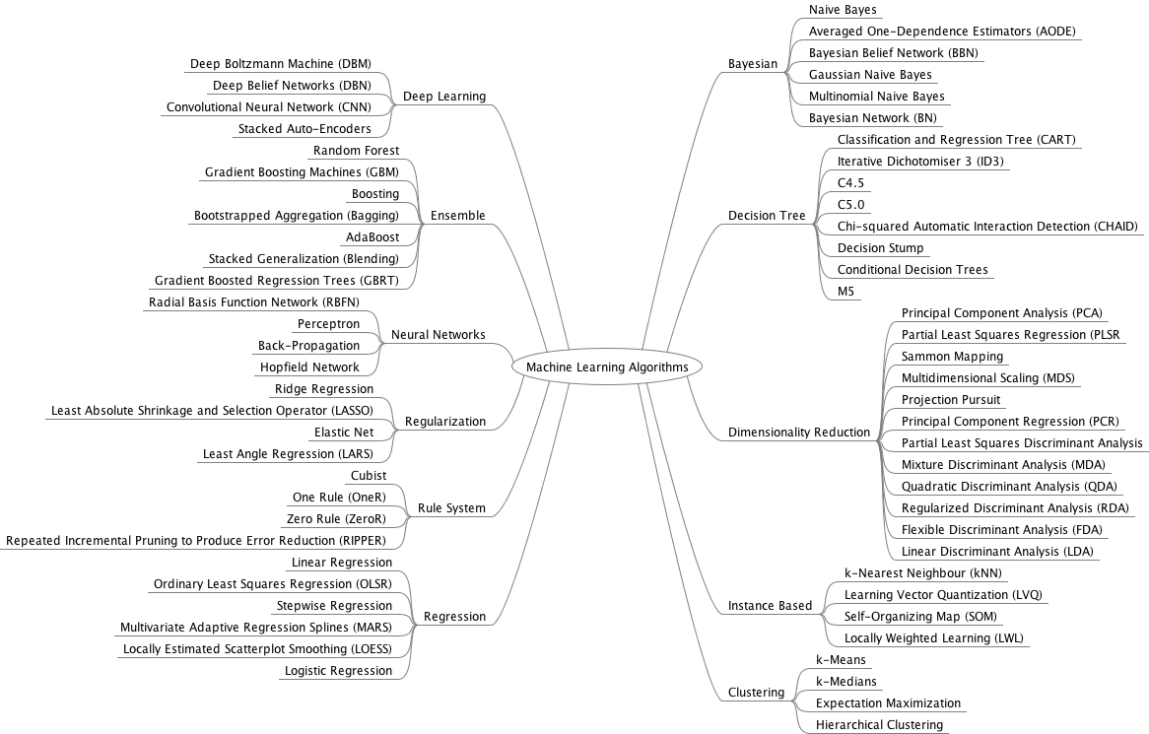
Algorithms:

Slide 21
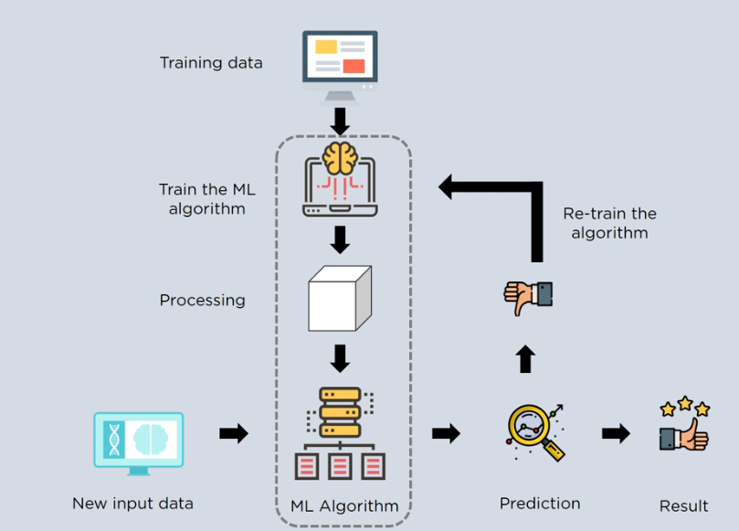
How does Machine Learning works?

Slide 22
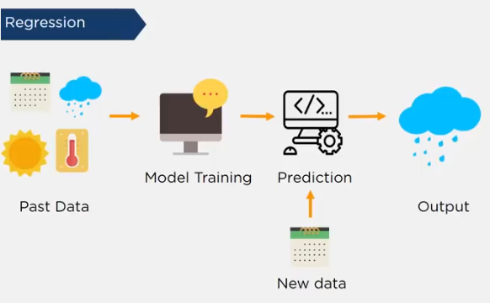
Supervised Learning
Machine learning model learns from the past input data and makes future prediction as output

Slide 23
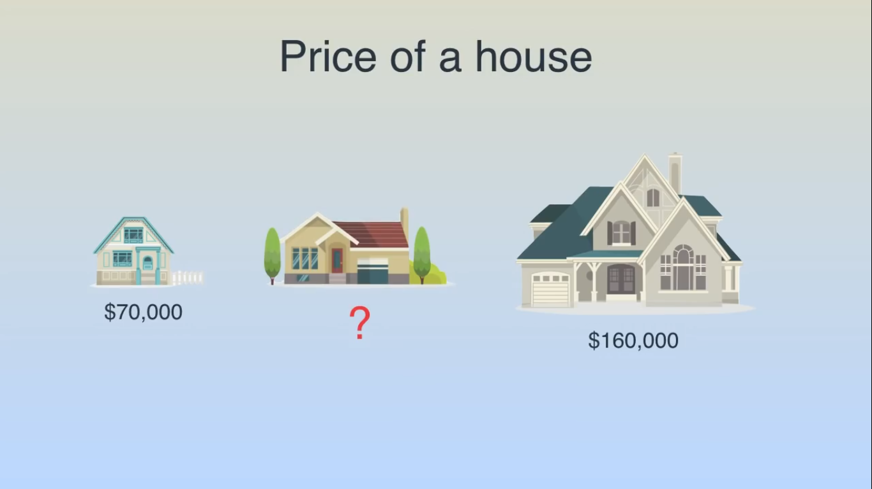
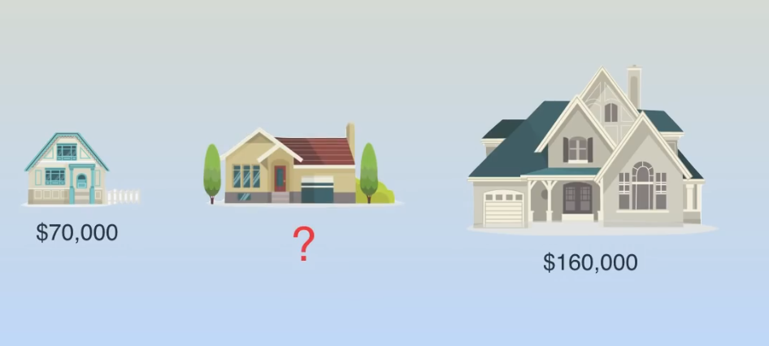
Price of a House

Slide 24
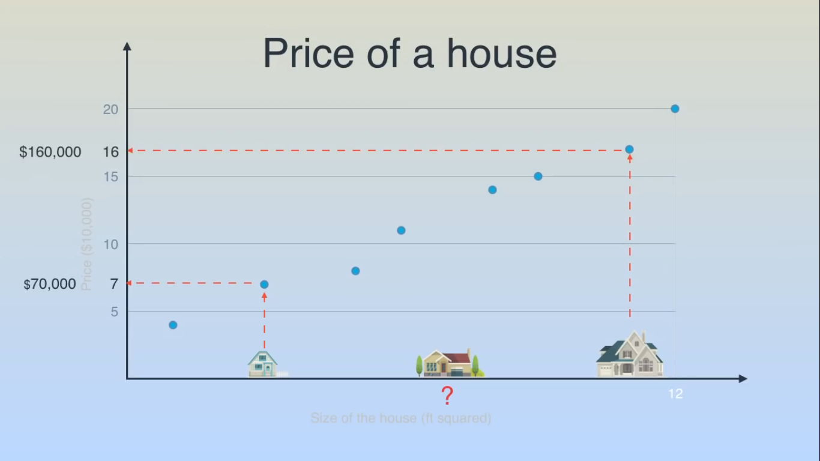
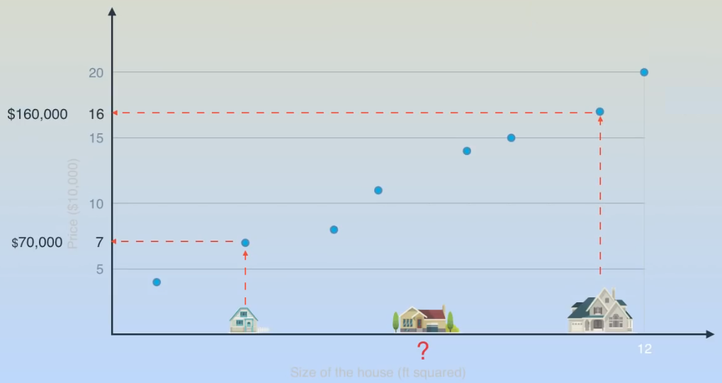
Price of a House

Slide 25
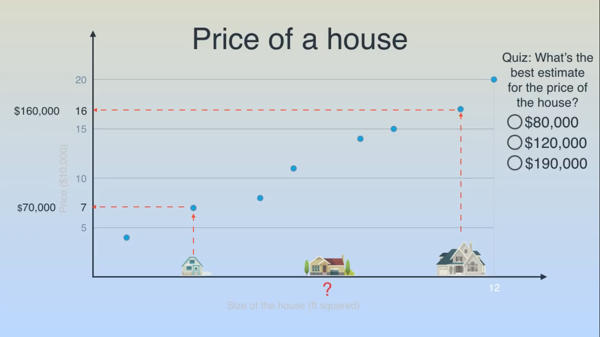
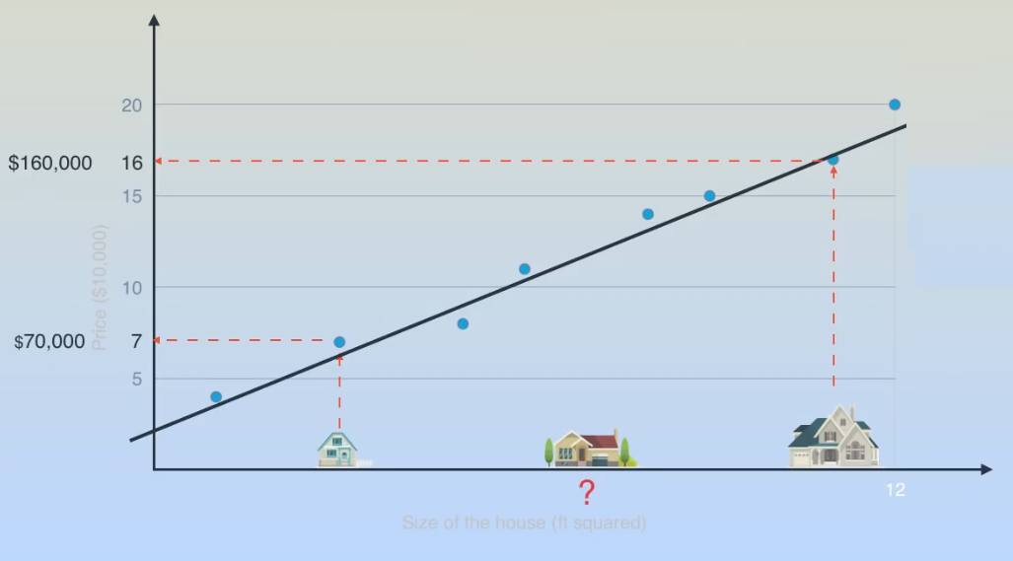
Price of a House

Slide 26
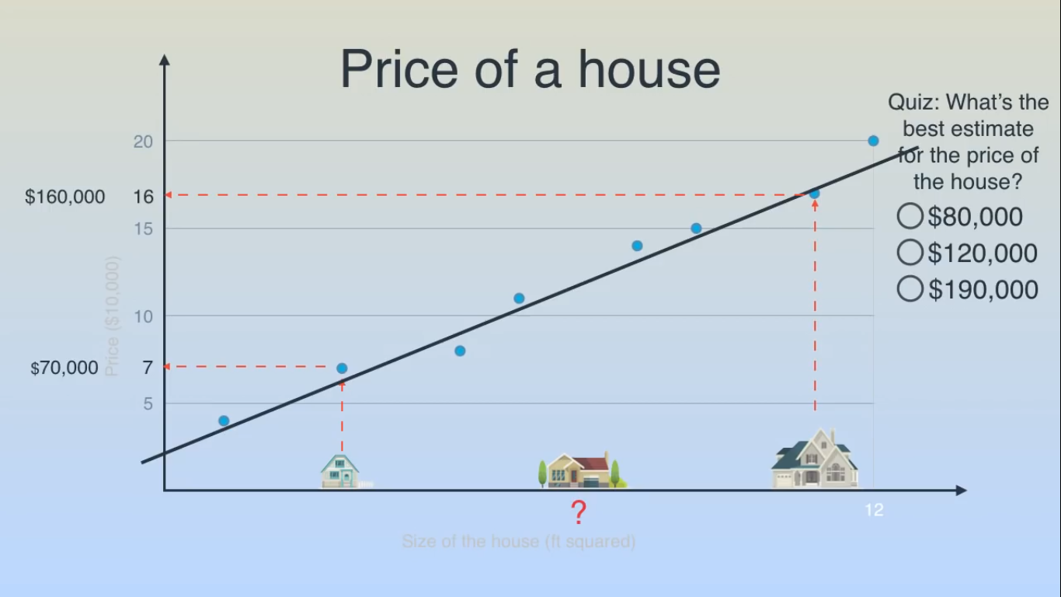
Price of a House

Slide 27
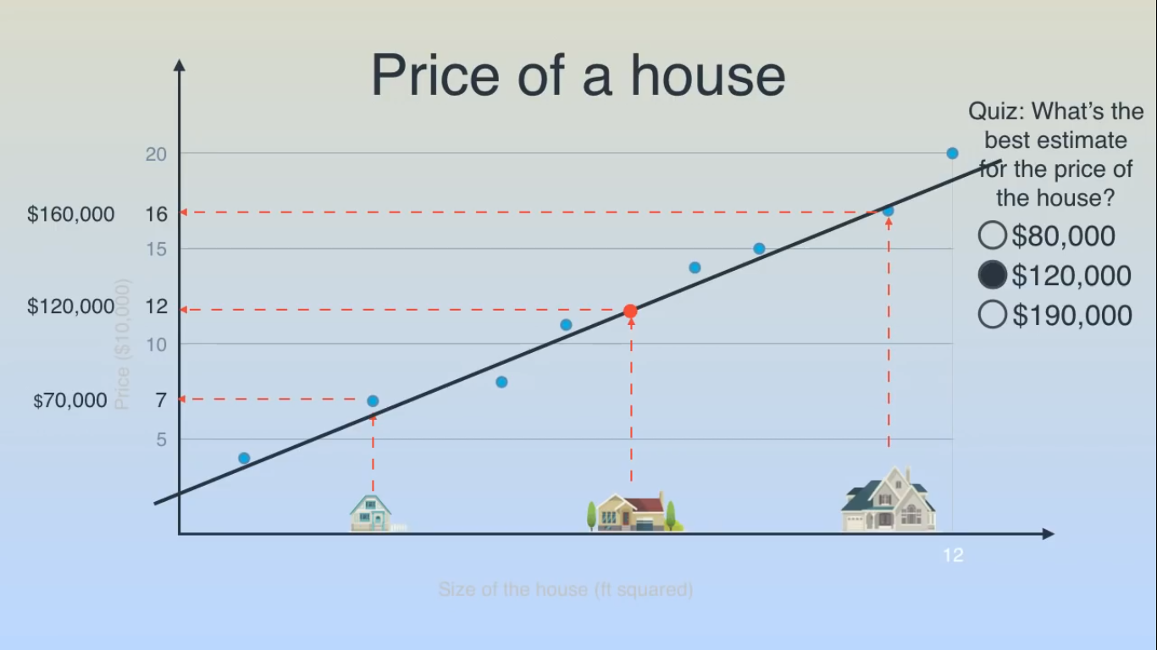
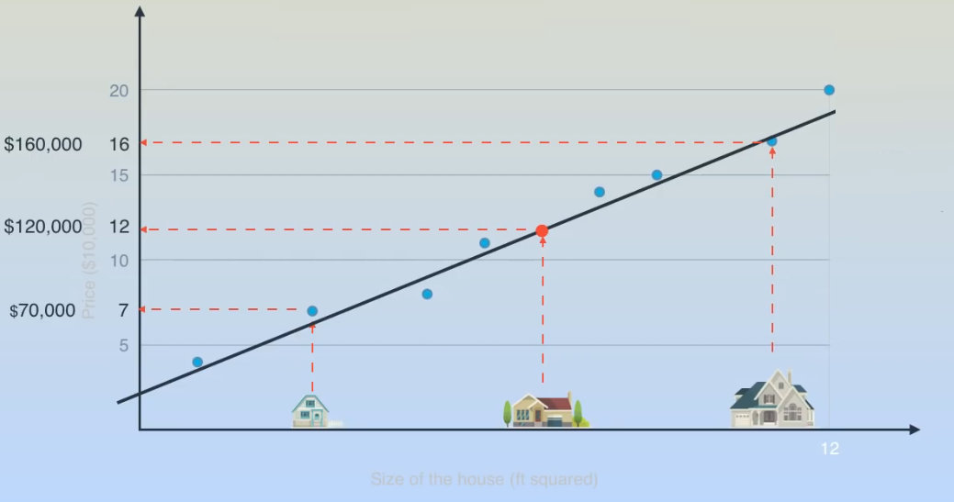
Price of a House

Slide 28

Price of a House
This Method is Called Linear Regression
How You Find This Line ?
Answer : Gradient Descent Method

Slide 29
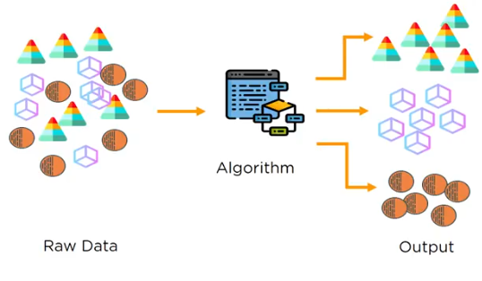
Un-Supervised Learning
Machine Learning Model uses unlabelled input data and allows the algorithm to act on that information without guidance

Slide 30
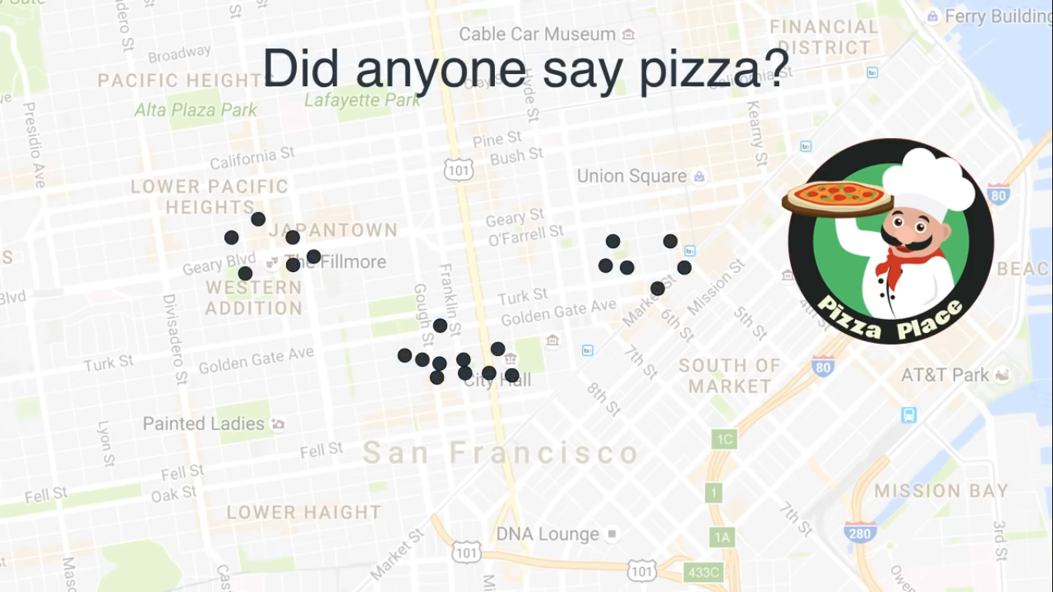

Slide 31
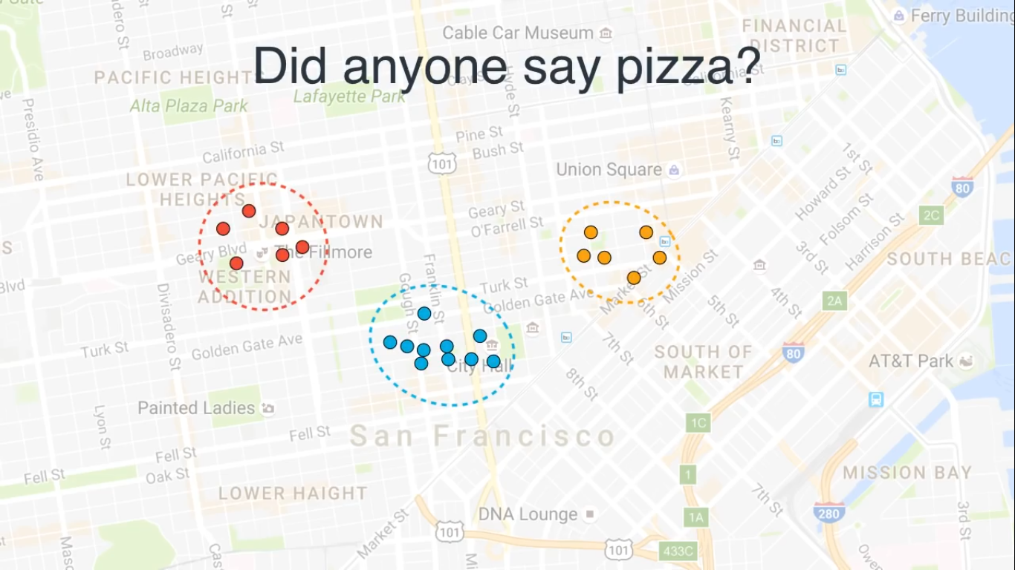

Slide 32
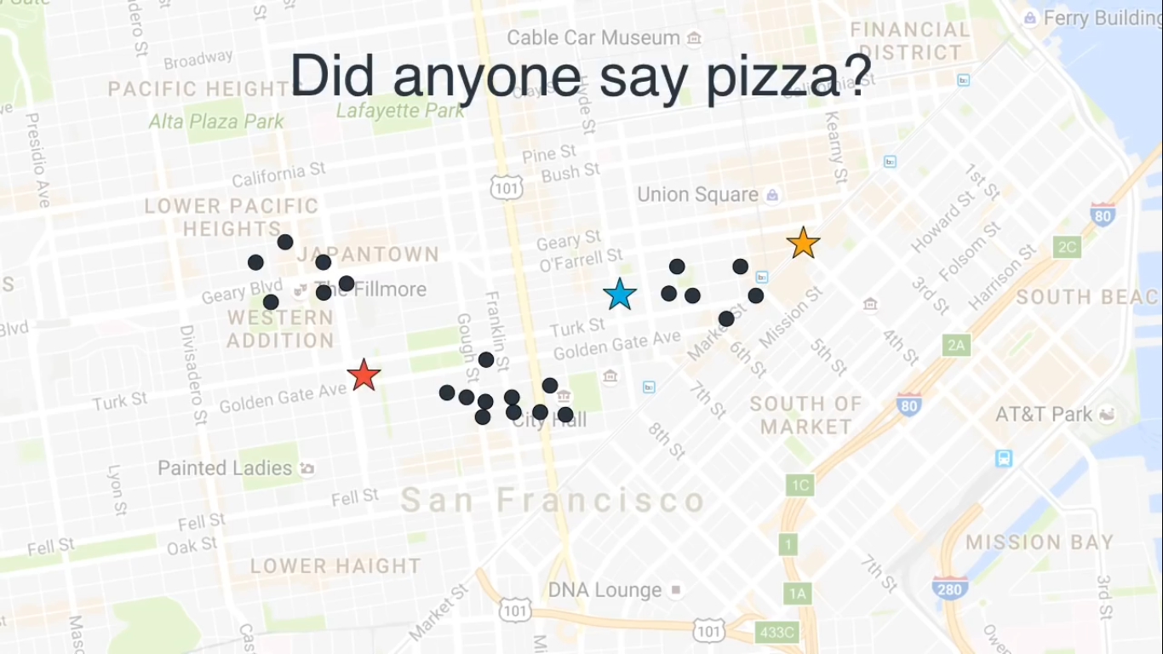

Slide 33
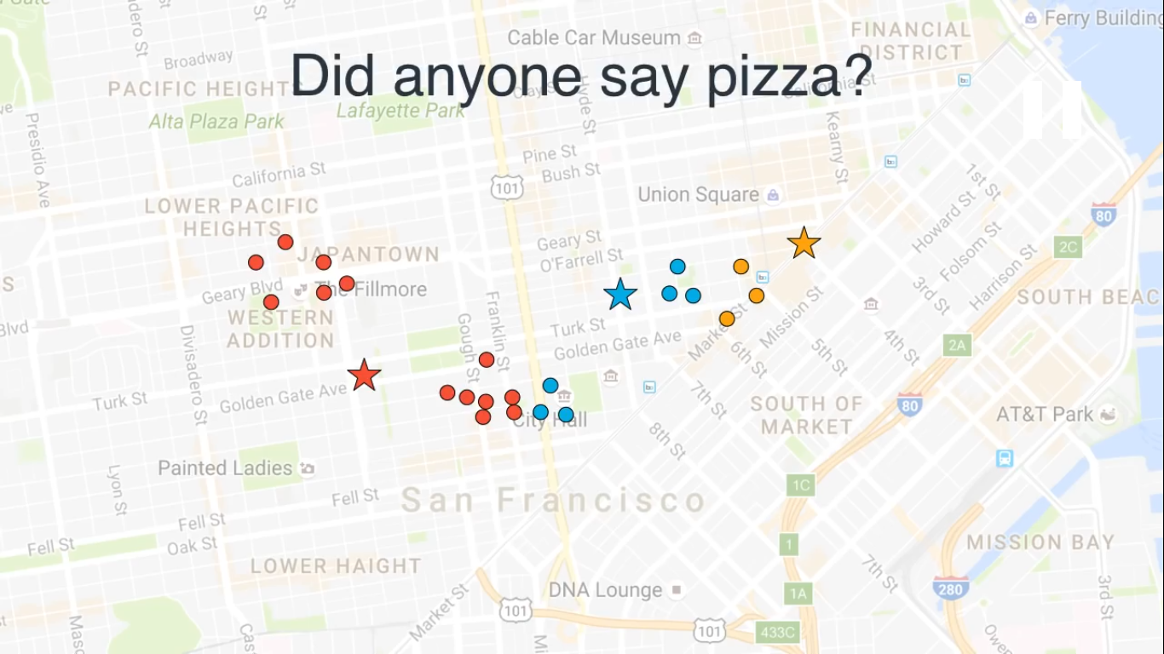

Slide 34


Slide 35
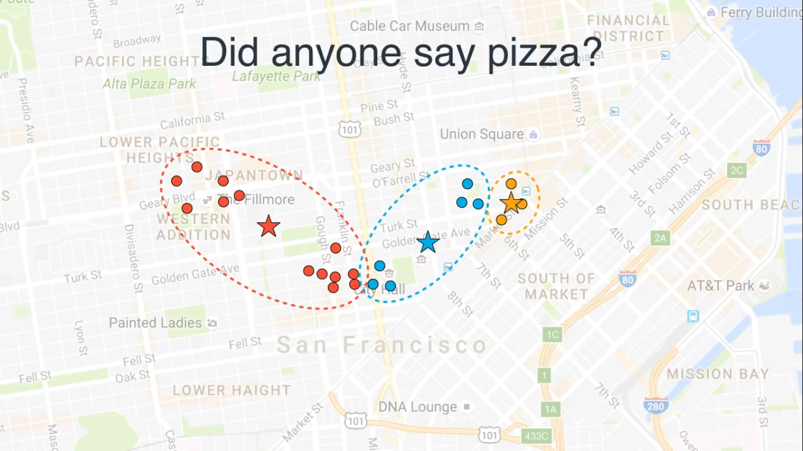

Slide 36
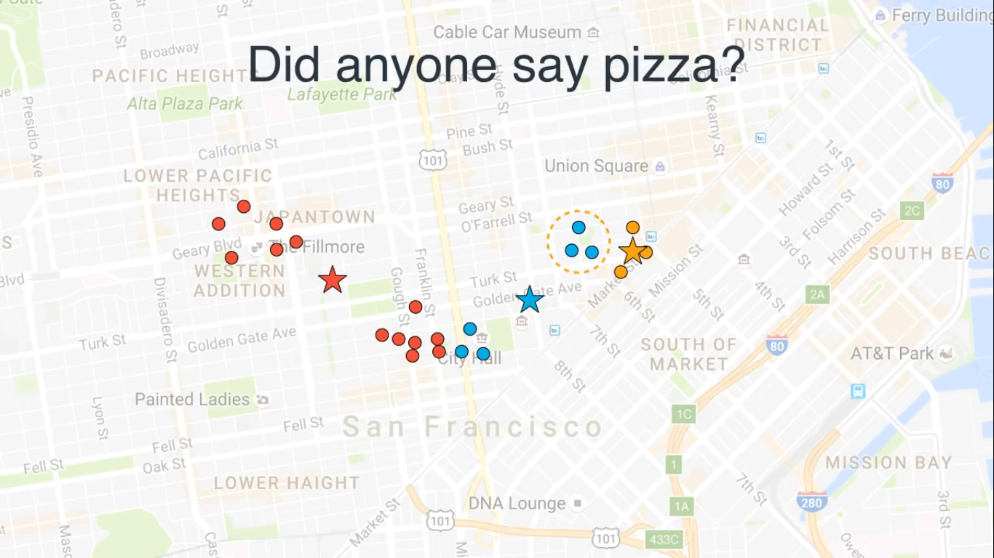

Slide 37
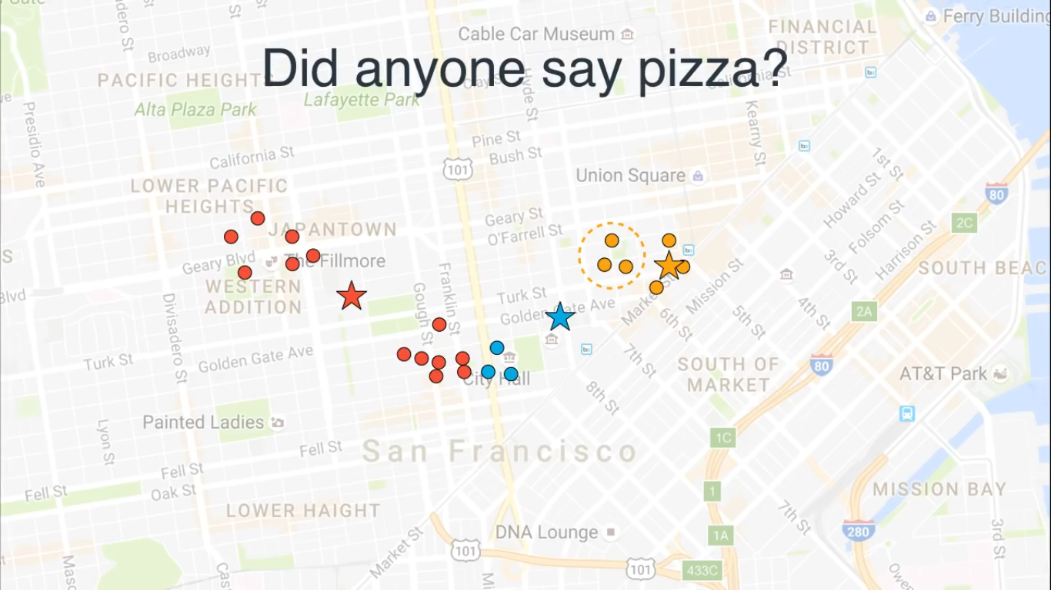

Slide 38


Slide 39


Slide 40
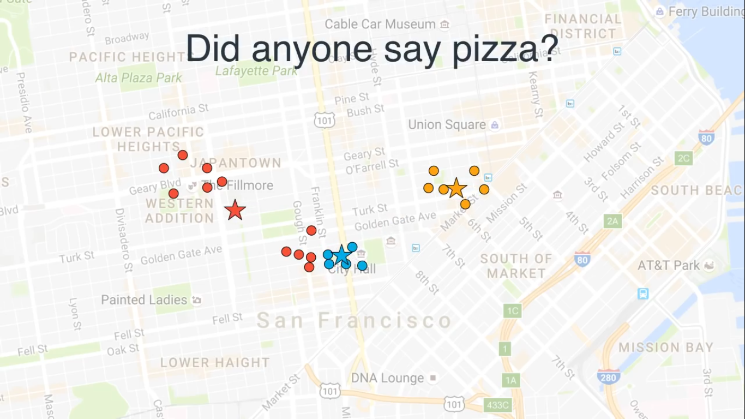

Slide 41


Slide 42
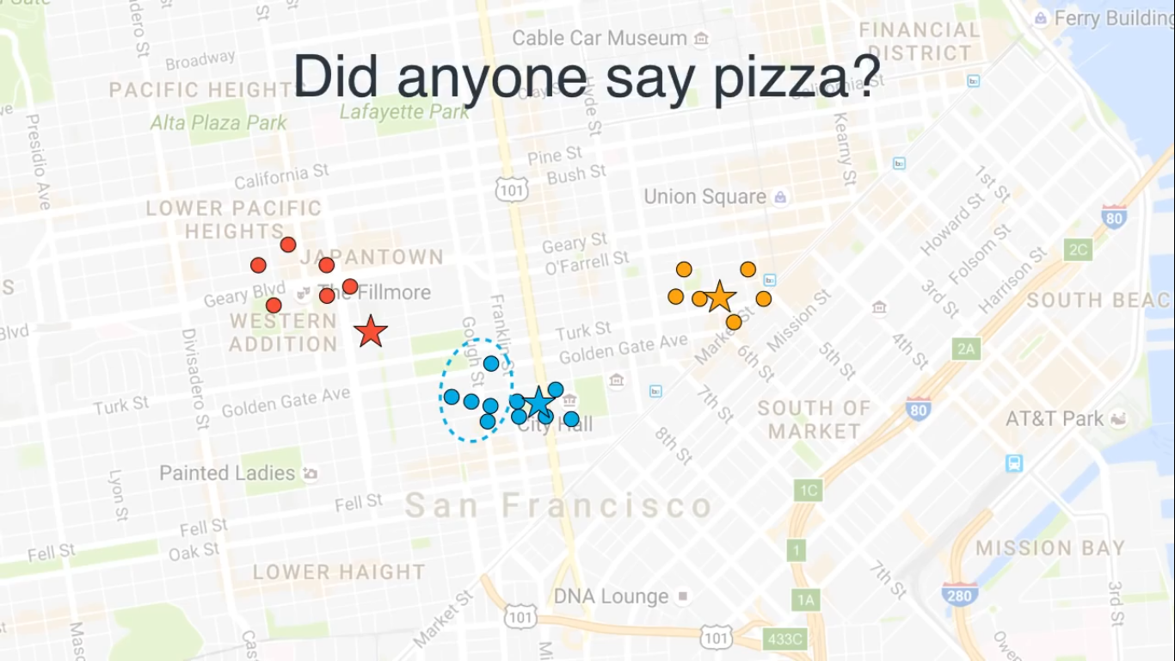

Slide 43
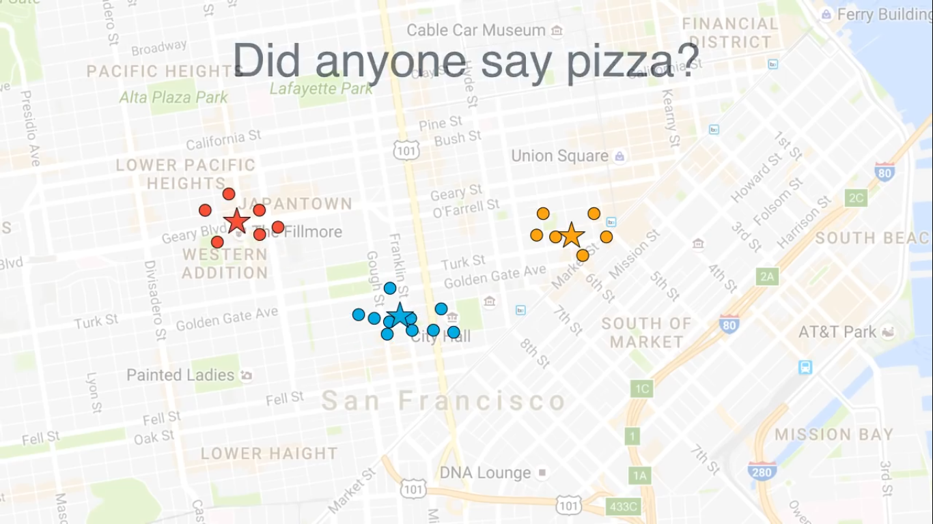

Optimal Places are found

Slide 44
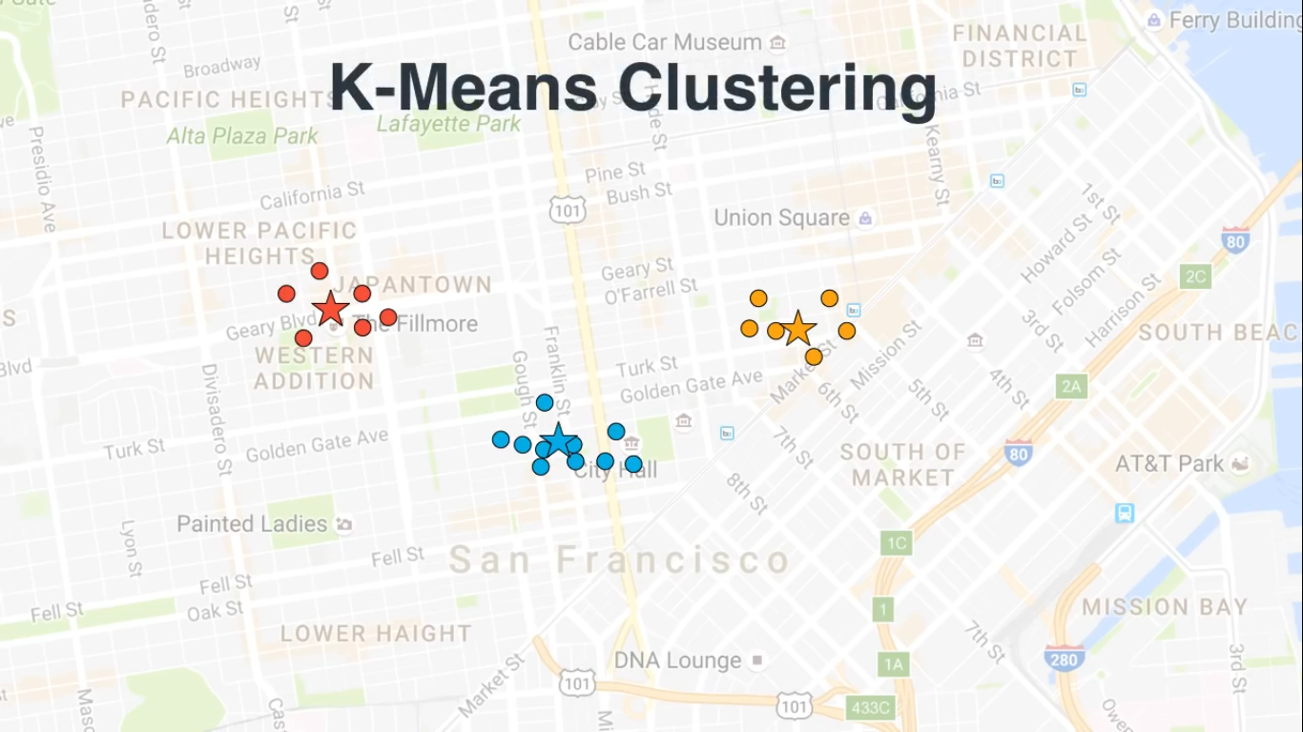

Slide 45
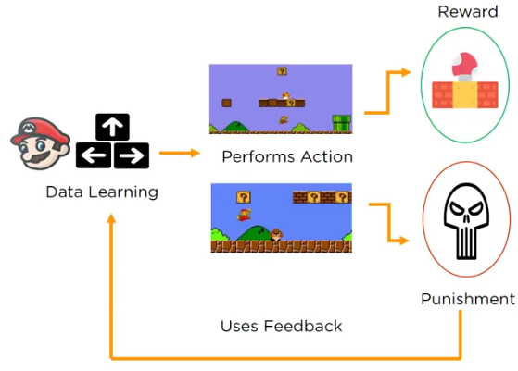
Reinforcement Learning
Reinforcement Learning involves teaching the machine to think for itself based on its past action reward.

Slide 46
Good Starting point...
https://codelabs.developers.google.com/codelabs/cloud-tensorflow-mnist/#0
https://www.coursera.org/learn/machine-learning
https://www.kaggle.com/learn/machine-learning
https://mlcourse.ai/prerequisites
https://www.fast.ai/
https://deeplearning.mit.edu/

Slide 47
Coding!
time

Slide 48

Special Thanks!
.
Mr. Shivaram (Prof . Vashikaran !)
Mr Vishal Sathwane

